Slide 1
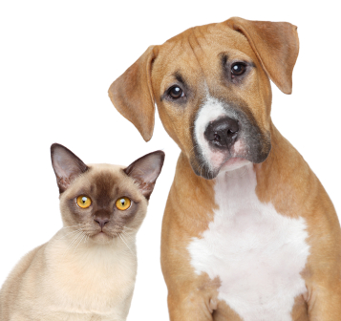
Dog or Cat ?
Zhihuan Xue
Lei Kan
Tianyuan Zheng

Slide 2
Face recognition
identification system
capture data
mark the images

Slide 3
Identifying human face
identifying faces of animals
much more complex

Slide 4
Application
Animal Insurance Field
Uniqueness of Certain Animals
Database of Animals
Provide Parameters of Environment

Slide 5
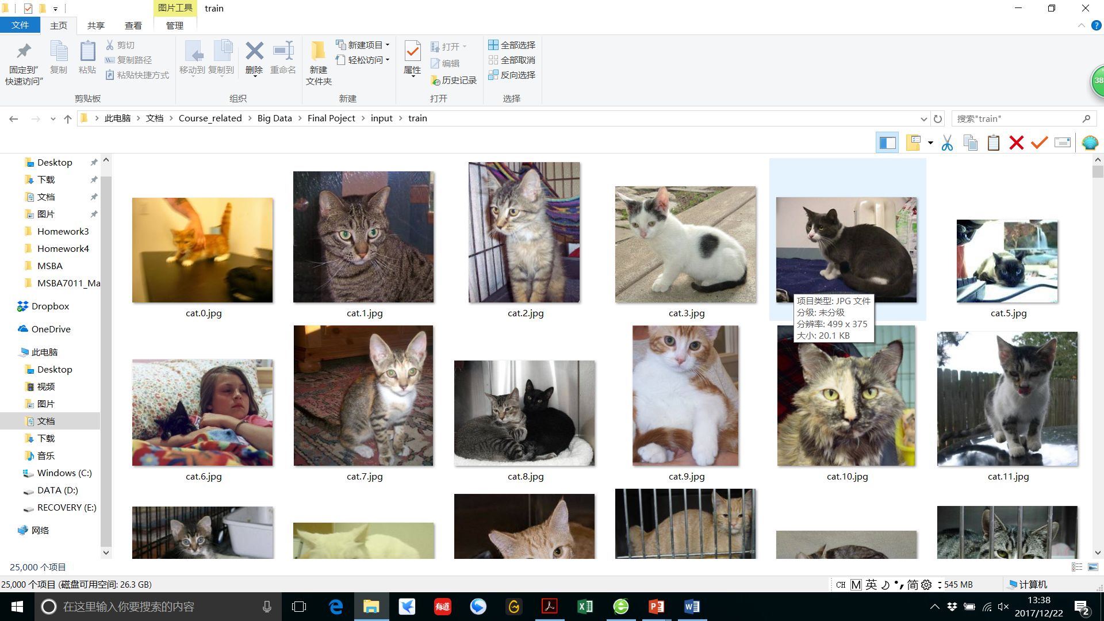
Data
Original Dataset
12,500 images of dogs
12,500 images of cats
Created by Microsoft Research
Downloaded from a Kaggle Competition

Slide 6
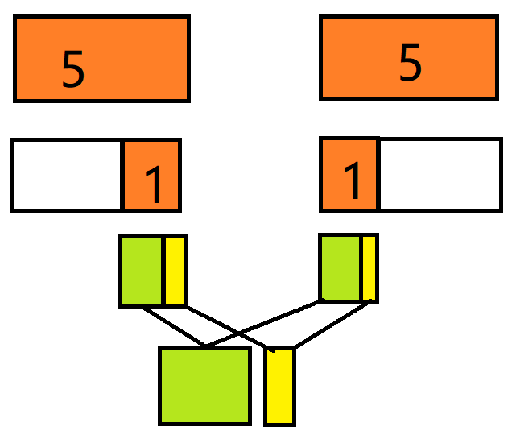
Select data
Randomly chose 1/5 of the original data
2500 images of dogs
2500 images of cats

Slide 7
Split for train set and test set
2000 for train set
500 for test set
Guarantee equal proportion of images of these two animals

Slide 8
Data augmentation
rotation
shift
flip
shear
zoom
Generate 20,000 new images of dogs
and 20,000 new images of cats
Notes:
Bring a Name card so that I know who is participating

Slide 9
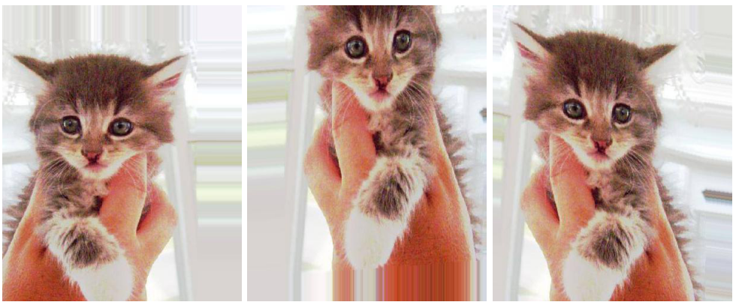
Data augmentation
Notes:
Bring a Name card so that I know who is participating

Slide 10
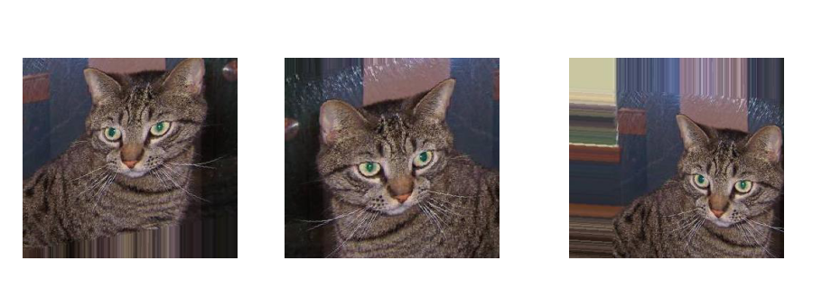
Data augmentation
Notes:
Bring a Name card so that I know who is participating

Slide 11
Label the Images
“1” for dogs
“0” for cats
One-hot

Slide 12
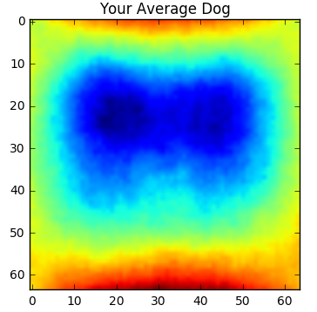
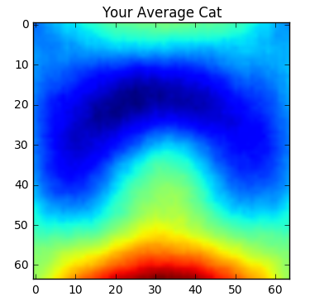
Average photo
use the mean pixel values

Slide 13
Choose neural network
We choose neural network following just one rule: whether it is widely used. A popular neural network means:
Achieve good balance between time cost and accuracy, otherwise people won’t use it
A mature neural network have more support from community like stackoverflow
More document about how to build the network

Slide 14
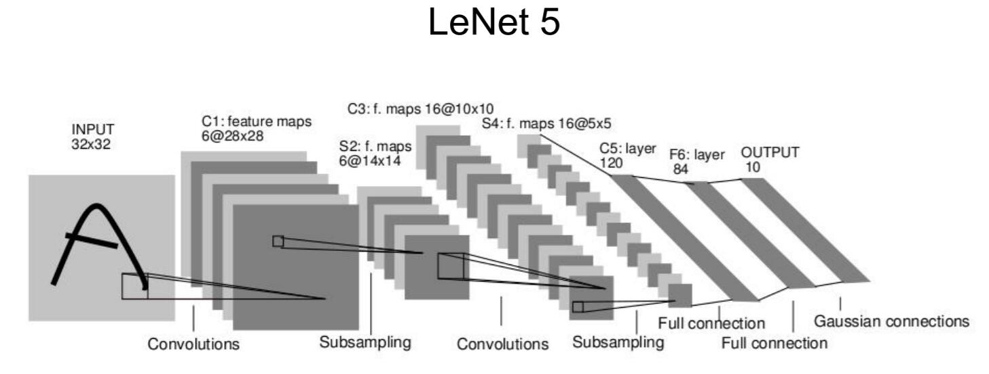
LeNet
LeNet was created by Yan LeCun, a famous computer scientist focused on machine learning, who is also known as a founding father of convolutional nets in 1998.
It has 2 convolution layers, 2 pooling layers and 2 connection layers, totally 7 layers. Convolutional filters are 5x5, applied at stride 1. Subsampling (Pooling) layers were 2x2 applied at stride 2. Architecture is [CONV-POOL-CONV-POOL-FC-FC].

Slide 15
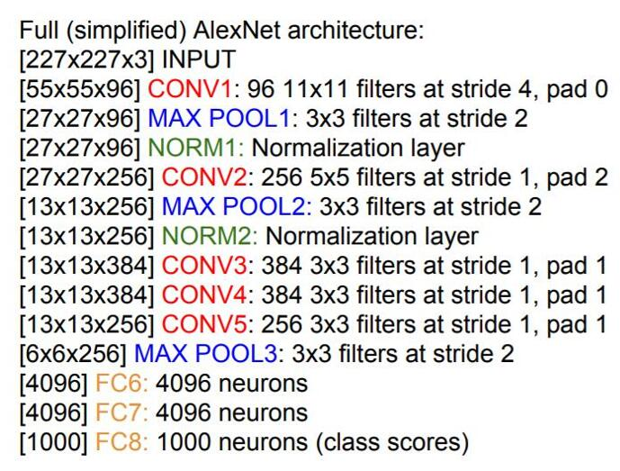
AlexNet
AlexNet was put forward by the SuperVision group in ImageNet Large Scale Visual Recognition Challenge in 2012, they had very clearly advantage over the second team with 15.3% vs 26.2% error.
The network was made up of 5 conv layers, max-pooling layers, dropout layers, and 3 fully connected layers. Architect is [CONV1 MAX POOL1 NORM1 CONV2 MAX POOL2 NORM2 CONV3 CONV4 CONV5 Max POOL3 FC6 FC7 FC8]

Slide 16
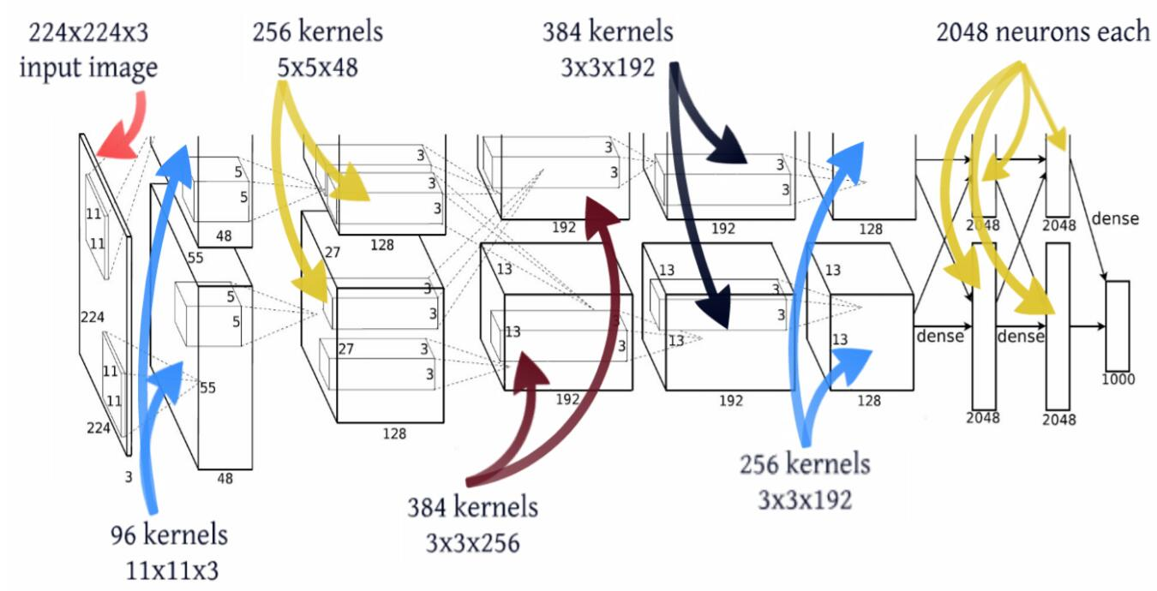
AlexNet

Slide 17
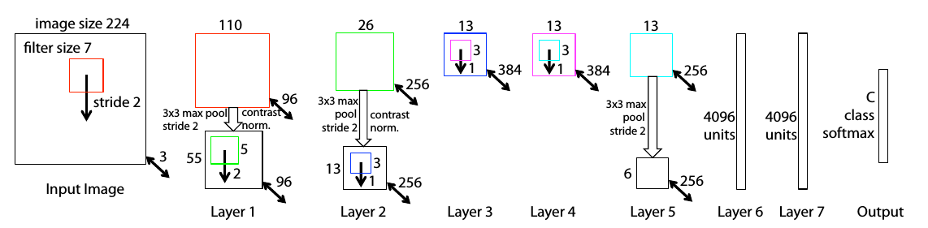
ZF Net
Compared with AlexNet, the architecture of ZFNet makes a fine tuning.
(1)In convolution layer 1, instead of using 11x11 sized filters, ZF Net uses filters of size 7x7 and a decreased stride value from 4 to 2 ;
(2) In convolution 3,4,5, instead of 384, 384, 256 filters, using 512, 1024, 512.

Slide 18
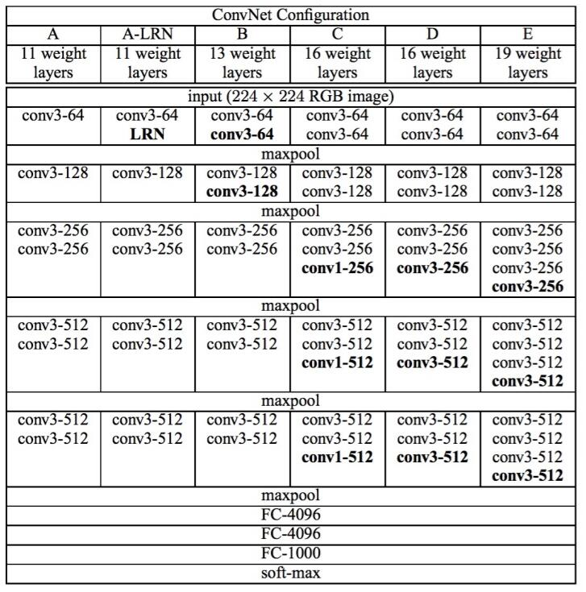
VGGNet
VGGNet uses only 3x3 sized filters which is quite different from AlexNet’s 11x11 filters in the first layer and ZF Net’s 7x7 filters.

Slide 19
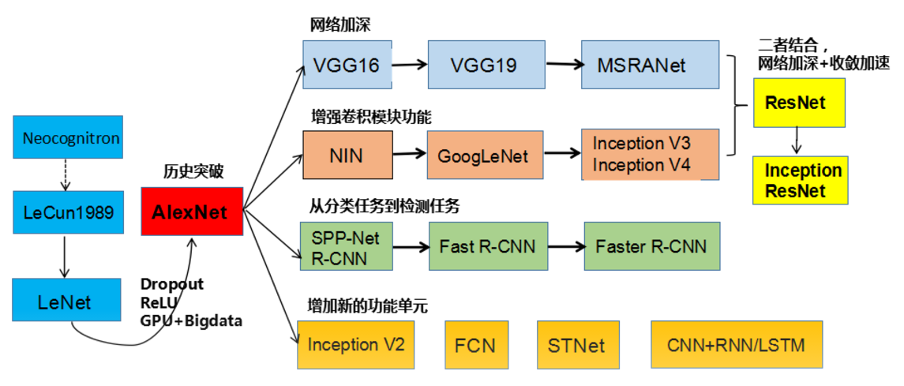
Deeper Network
A combination of the Two
Augment Convolutional Function
Historical Breakout
From Classification to Detection
Add New Function Units

Slide 20
Input Data Shapes
X Shapes:
(None, 64,64,3)
Y Shapes:
(None,2)

Slide 21
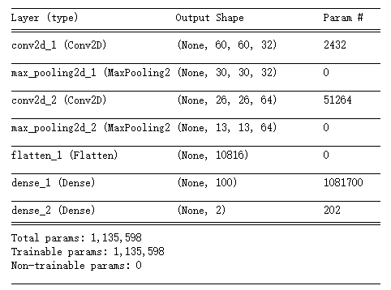
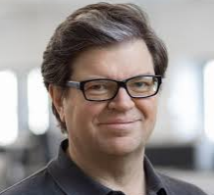
Our Model Structures----LeNet（1986）
A Basic Structure
Created by Yan LeCun

Slide 22
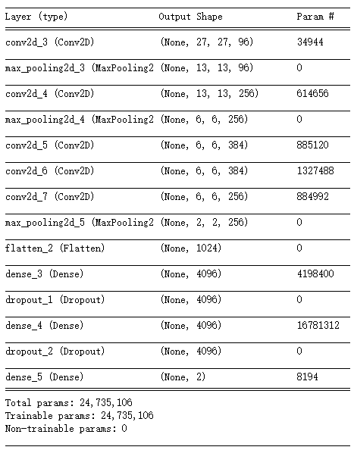
Our Model Structures----AlexNet(2012)
1. Data Augmentation
2. Relu: f(x)=max(0,x)
3. Dropout
4. Local Responce Normalization(LRN)
5. Multi-GPU

Slide 23
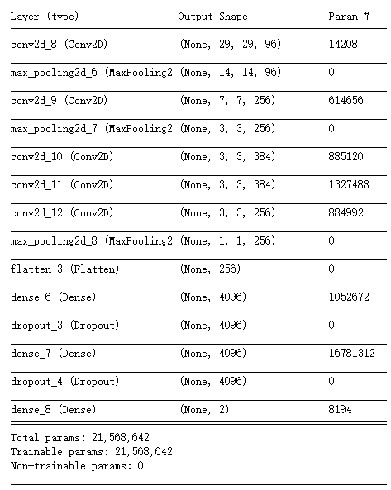
Our Model Structures----ZFNet(2013)
Slight Change from AlexNet
First Conv2d Changes:
Kernel Size (11→7)
Stride (4,4→2,2)
Other Changes:
Double GPU → One GPU
More Kernels for Conv

Slide 24
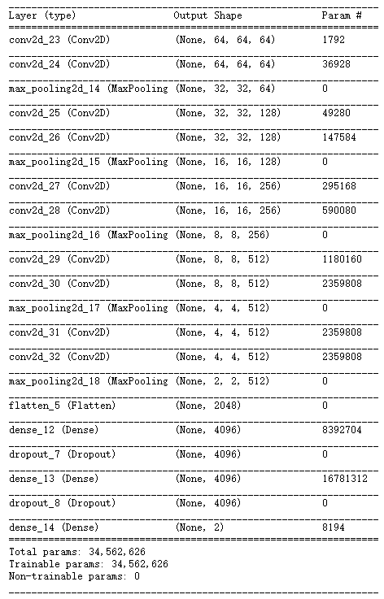
Our Model Structures ----VGG(2014)

Slide 25
Other Possible Approaches
Other Parameters
(eg: activation=“sigmoid”, loss = binomial_crossentropy)
Other Models
(eg: GoogleNet, ResNet ……. )

Slide 26

Training

Slide 27
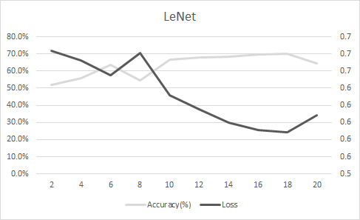
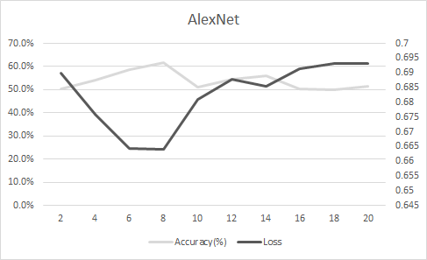
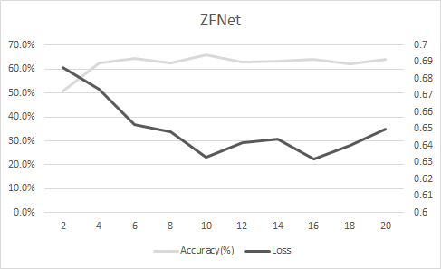
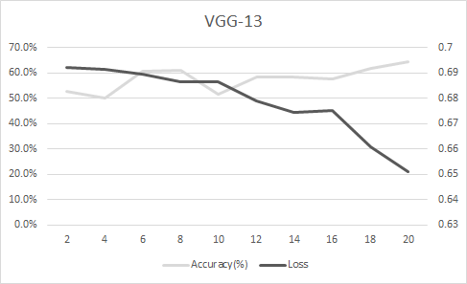
Testing

Slide 28
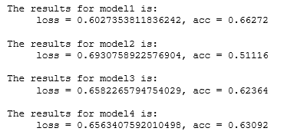
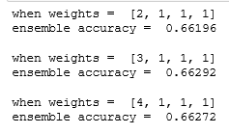
Model Ensemble Conclusion

Slide 29
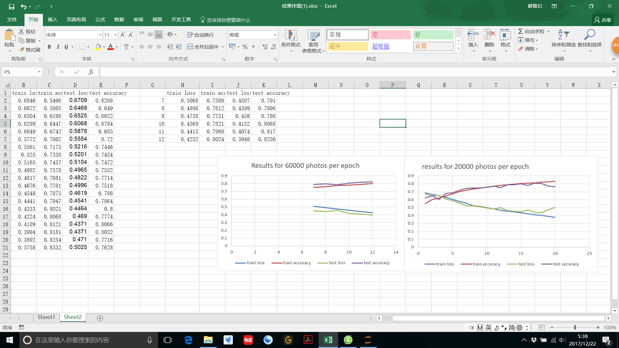
Data Augmentation Conclusion
Epoch No.
Photo No.
0 420000 720000
0 200000 400000

Slide 30
Thank you!
Q & A

